Slide 1


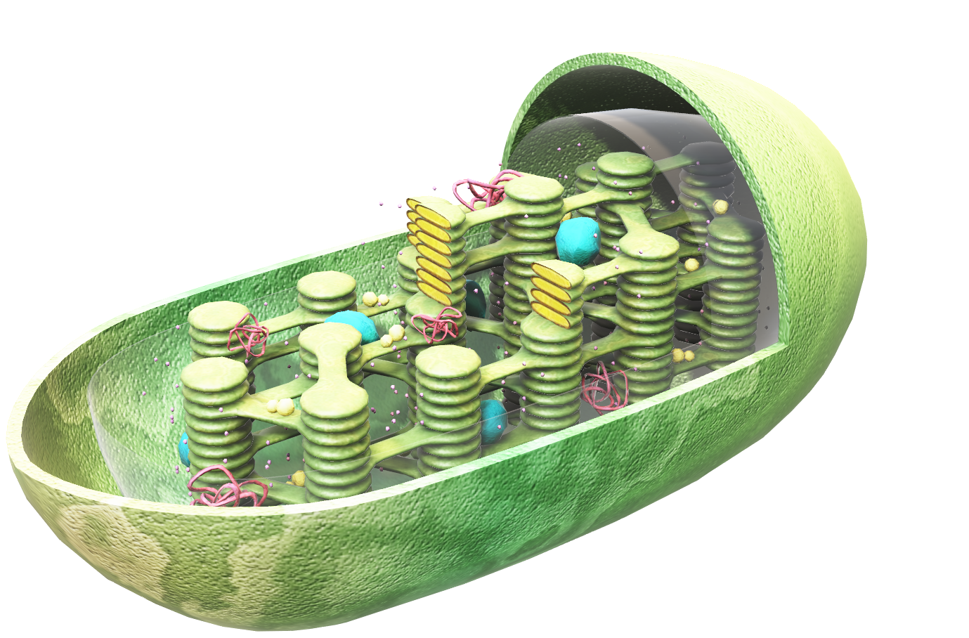
Duration: 115 min
High School
Grade: 9 - 12
CCSS, NGSS
How plants gain energy
Life science, Plant Biology
Click on the model to interact

Slide 2

Lesson overview
Photosynthesis is an energy production process undertaken by plants and green algae. It consists of various steps, during which energy coming through sunlight is converted into stored, chemical energy. It has special importance also for animals and humans, because a secondary product of the reaction is oxygen, necessary for the respiration of all living organisms.
Learning objectives
Keywords
Learn what materials and conditions are needed for photosynthesis.
Understand the process of transforming the input substances and sunlight into new products.
Learn about the plant structures that participate in this process.
Photosynthesis, Chloroplasts, Chlorophyll, Carotene, Xantophyll, Thylacoid, Plants, Algae, Carbon dioxide, Water, Sunlight, Energy, Oxygen, Glucose, Starch, Sugar
Standards
Common Core CCSS ELA-Literacy 11-12.RI.7
Integrate and evaluate multiple sources of information presented in different media or formats as well as in words in order to address a question or solve a problem.
11-12.W.7
Conduct short as well as more sustained research projects to answer a question (including a self-generated question) or solve a problem; narrow or broaden the inquiry when appropriate; synthesize multiple sources on the subject, demonstrating understanding of the subject under investigation.
11-12.SL.1
Initiate and participate effectively in a range of collaborative discussions (one-on-one, in groups, and teacher-led) with diverse partners on grades 11–12 topics, texts, and issues, building on others’ ideas and expressing their own clearly and persuasively.
11-12.SL.2
Integrate multiple sources of information presented in diverse formats and media (e.g., visually, quantitatively, orally) in order to make informed decisions and solve problems, evaluating the credibility and accuracy of each source and noting any discrepancies among the data.
11-12.SL.5
Make strategic use of digital media (e.g., textual, graphical, audio, visual, and interactive elements) in presentations to enhance understanding of findings, reasoning, and evidence and to add interest.
NGSS
HS-LS1-5
Use a model to illustrate how photosynthesis transforms light energy into stored chemical energy.

Slide 3
1. Introduction
5
min
The photosynthesis reaction is well known to all students from the very early years of their education. However, the process is very complex and there are always new facts which can help them to a deeper understanding of this phenomenon. In this lesson, they can learn some further details beyond the basic formula of photosynthesis they certainly already know. 3D models will help them visualize the different phases of the reaction and so to understand and remember more about the problem.
To begin, warm up a little bit by conducting a short discussion:
Can they explain what photosynthesis is?
What is the meaning of the word?
Which organisms can perform photosynthesis?
What is the use of photosynthesis?

Slide 4
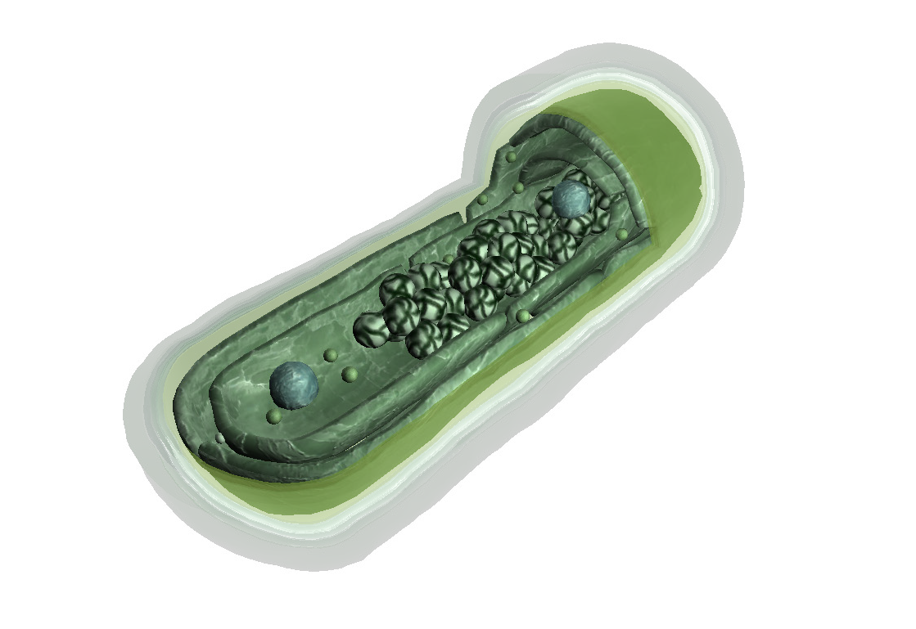
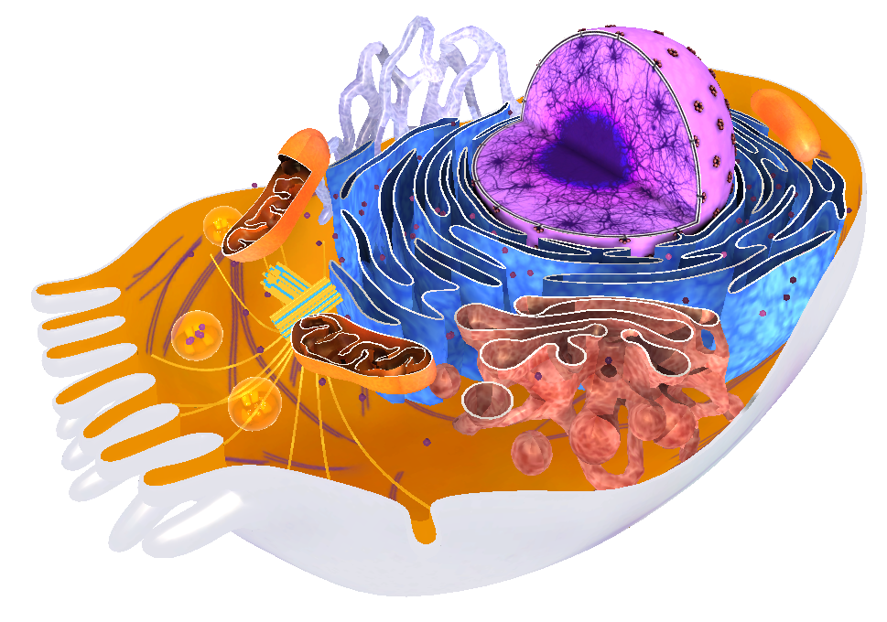
2. History
15
min
The history of photosynthesis begins a long time back, nearly at the midpoint of the total age of Earth. When water appeared in its liquid state, forming extensive oceans on Earth’s surface, and offered enough protection for the first life on Earth to begin, it started as nothing more than small organic molecules created by the synthesis of inorganic material present on Earth. Nobody knows exactly how this happened, however it led in time to the creation of other, more complex molecules, such as phospholipids, amino acids, etc. Probably between
3.9 and 3.5 billion years ago, the first organisms, such as simple prokaryotes, appeared.
Those organisms were the only inhabitants of Earth until 2.1 billion years ago. We can date to this period the appearance of quantities of oxygen in the atmosphere. This change was possible because of the first photosynthesizing organisms. These were the cyanobacteria, which still exist today. You can observe them in the Lifeliqe Animal Biology library, in a model called “Cyanobacteria”. These simple organisms, which were the first oxygen producers, gave the atmosphere its significant proportion of oxygen and made possible the development of organisms outside of a watery environment, which occurred in later periods of Earth’s history.
At about 1 billion years ago, this development advanced to the appearance and diversification of eukaryotic cells. This happened most probably when a bacterial cell attempted to digest another one, which instead survived inside the predator cell and converted itself into an organelle typical of animal eukaryotic cells, the mitochondrion. Mitochondria then served as “energy factories” for whole eukaryotic cells. You can observe mitochondria and other organelles in the model “Somatic Cell”, found in the Human Biology library of the Lifeliqe app.
Click to open in Lifeliqe
Click to open in Lifeliqe

Slide 5
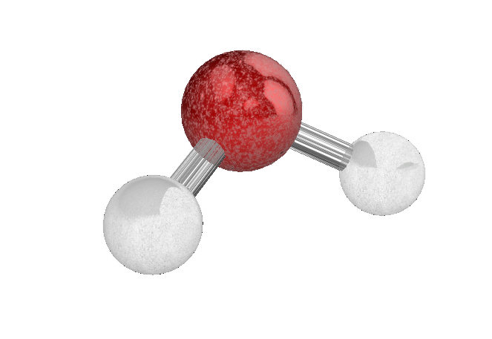
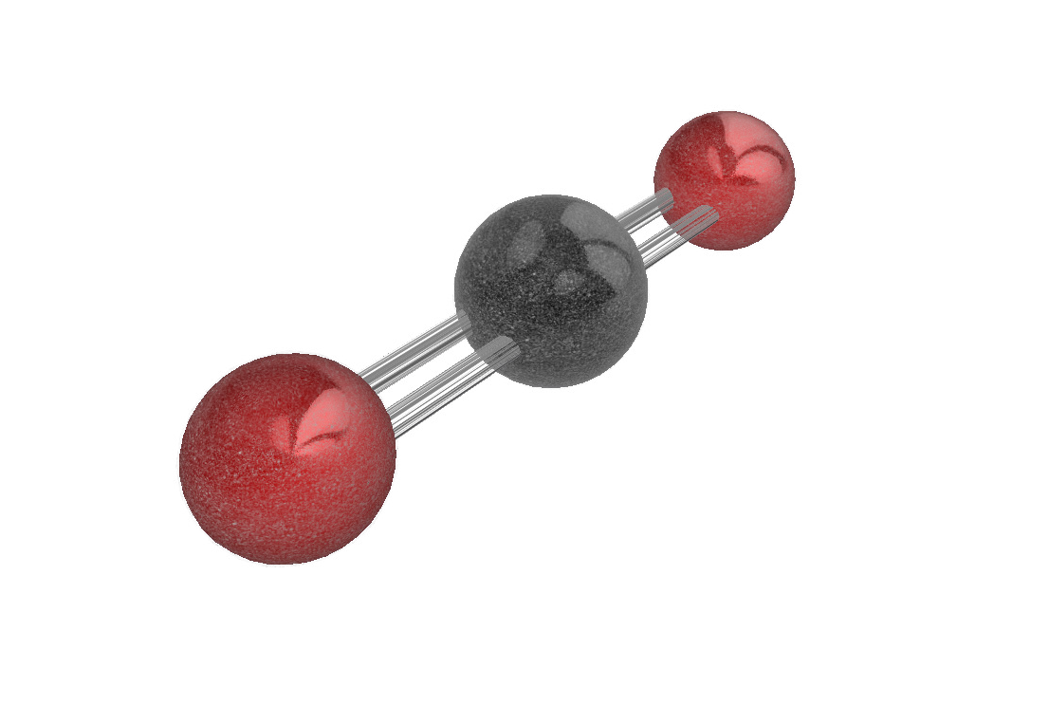
3. Input
30
min
In this part of the lesson, explain to your students what input materials are needed for the photosynthesis reaction. If you have your students think about the necessities of each living plant’s survival, the question will be answered automatically.
The first important constituent of the photosynthesis reaction is water. Water is absorbed from the soil by the plant’s roots and delivered to all the rest of the plant by a system of internal plumbing. Apart from bringing in minerals needed by the plant, it is an important constituent for growth and photosynthesis. From the chemical point of view, water is a simple compound composed of one atom of oxygen and two of hydrogen. If you open the Lifeliqe Chemistry library, you will find there a model of this basic molecule. Type into the search box “Water”, open the 3D model, and show it to the students.
The other important input substance of photosynthesis is “Carbon Dioxide”, which again can be found in the Lifeliqe Chemistry library. Carbon dioxide is one of the constituents of Earth’s atmosphere, though forming just 1% of its total volume, nonetheless making it the third most important gas present there. It is produced during our breathing. Plants take it from the air and use it as the second substance needed for photosynthesis. Take a look at the model of this simple compound and identify the two basic elements which it is made of.
The last important input needed to run the process is energy. This is provided by the sun. Sunlight is used to break the water molecules when it hits the green colored chlorophyll hidden in the chloroplasts. In these organelles everything important in the process happens, during several phases finally leading to the processing of the compounds through which plants store energy. But this part will be explained later; first, take a look with your students at the structure of the chloroplasts, the place where photosynthesis occurs!
Click to open in Lifeliqe
Click to open in Lifeliqe

Slide 6
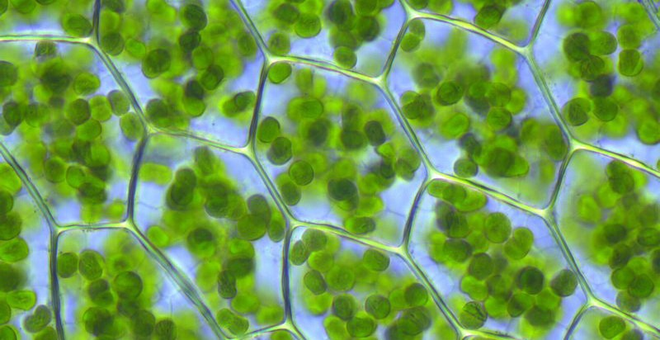
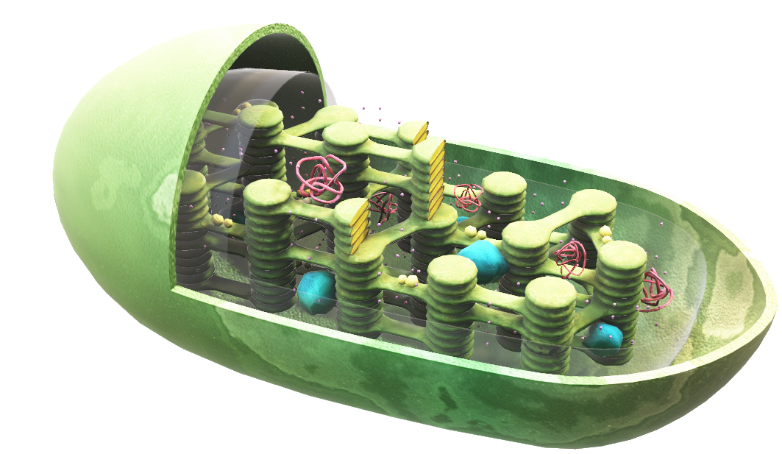
4. The power of green
15
min
In this part of the lesson, you should dedicate some time to studying the organelle responsible for photosynthesis, the chloroplast. The whole process we are speaking of happens here, inside this organelle. Chloroplasts are specific because of their shiny green coloring called chlorophyll, which gives the plants their typical coloration. First, highlight them in the “Plant Cell” model, clicking on the Chloroplasts part, to show how they are situated inside the cell. You can also show students photos of specific plants, where the chloroplasts can be seen clearly and in detail. A good example is this photo of moss cells where these organelles are clearly observable! Then open a specialized, detailed model of the organelle. Look for the “Chloroplast” model inside the Plant Biology library. Ask the students to observe it, beginning with a description of its general structure. Tell them that chloroplasts are disc-shaped organelles found in the cytosol of a cell. If your students look at the model, they will discover that the chloroplasts also have a complex internal structure. Describe this, starting with the two membranes: one inner and one outer. In between these there exists a gap called the intermembrane space. Highlight the respective parts of the model, clicking on them in the description panel or directly on the picture. Then continue with a description of the inner parts of chloroplasts. The most important part of the organelle, the thylakoids, can be found, grouped and interconnected in stacks called grana (singular granum), which contain chlorophyll. The inner space of chloroplasts is called the lumen, while the inner part surrounding the thylakoids is called the stroma. In the model we can also find starch, which appears as the result of the energy production process of photosynthesis.
When you have finished the description, tell the students that green chlorophyll is not the only pigment present in chloroplasts. There are also others, carotene and xanthophyll, which are covered up by the strong green color of chlorophyll, so they are usually invisible to the human eye. However, sometimes the other colorings reveal their beauty, as on some trees during the fall, when the green chlorophyll disappears from the leaves and so the other pigments become visible. When all the colorings disappear, the leaves are just brown. Tell the students more about the other colorings, and then search for some beautiful pictures of colored leaves!
Kristian Peters -- Fabelfroh, Plagiomnium affine laminazellen, CC BY-SA 3.0
Click on the model to interact

Slide 7
5. Experiment – photosynthesis under different conditions
70
min
Now let’s examine the conditions which can influence the rate of photosynthesis!
Tools
Willmott’s bubbler
Hydrilla
Water
Vaseline
Blue, green, and red color paper
Sodium bicarbonate
Thermometer
Instructions
Fill the bubbler with pond water.
Cut some hydrilla plants, tie them, and insert them into the narrow part of the bubbler so that their cut ends point upwards.
Add a precise quantity of sodium bicarbonate to the water (e.g., 250 mg) and count the number of the bubbles in a determined time (e.g., 2 min). Note down the result, then add another portion of sodium bicarbonate and count the bubbles again. Repeat the process, until completing a table like the above with the results of your measurements.
Measurement Number | Time | Sodium bicarbonate concentration | Number of bubbles
1 | 2 min | 250 mg | 16 bubbles
2 | ¨ | 500 mg
3 | ¨ | 750 mg
4 | ¨ | 1 g
5 | ¨ | 1,25 g
6 | ¨ | 1,5 g

Slide 8
Prepare the same apparatus again, but now instead of adding sodium bicarbonate, expose it to sunlight for various times. Conduct an experiment, changing the periods of sunlight and shadow for definite times and count again the bubbles during it, noting down the results into another table.
Measurement Number | Time | Conditions | Number of bubbles
1 | 2 min | Sun | 13 bubbles
2 | ¨ | Shade
3 | ¨ | Sun
4 | ¨ | Shade
5 | ¨ | Sun
6 | ¨ | Shade

Slide 9
5. Another round of the experiment will consist in exposing the apparatus to light of different colors. Cover the bubbler with red-, green-, and blue-colored papers, and again count the number of bubbles in a definite time period. Note down the results.
Measurement Number | Time | Number of bubbles – red light | Number of bubbles – blue light | Number of bubbles – green light
1 | 4 min | 29 bubbles | 23 bubbles | 12 bubbles
2 | ¨
3 | ¨
4 | ¨
5 | ¨
Average | ¨

Slide 10
6. The last measurements will be taken at different temperatures of water. Heat it with an electric heater to a determined temperature and count the bubbles. Repeat the measuring at various times with different temperatures.
7. Draw conclusions. How have all the observed factors influenced the number of bubbles (i.e., on the rate of photosynthesis)?
Measurement Number | Temperature | Time | Number of bubbles
1 | 15 °C | 2 min | 22 bubbles
2 | 20 °C | ¨
3 | 25 °C | ¨
4 | 30 °C | ¨
5 | 35 °C | ¨
6 | 40 °C | ¨

Slide 11

Thanks for using Lifeliqe's lesson plan!
Excite your students in learning science with 1,000+ more 3D models and lesson plans at online.lifeliqe.com

